Slide 1
Finger Pointing to the moon

Slide 2
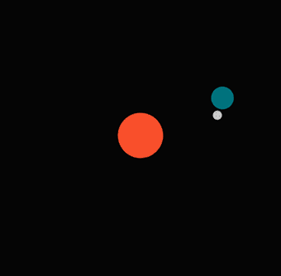
The only correct direction?
You think your finger pointing direction to the moon is the only right one? Think again!!!

Slide 3
Scientific proof
Tool: http://www.sciencekids.co.nz/earth_sun_moon.swf
Add two markers to the globe, white one on the East and yellow on the West. Each marker represents the location of each actor.
3 captures from the animation, at each capture, each actor points to the moon (if they can see it), representing by the arrow direction.
The sun is also orbiting around the center of the Milky Way Galaxy at the speed of 828,000 km/hr that takes 230 million years to complete one cycle.
GOAL: Observe the direction of the arrow from bigger view!

Slide 4
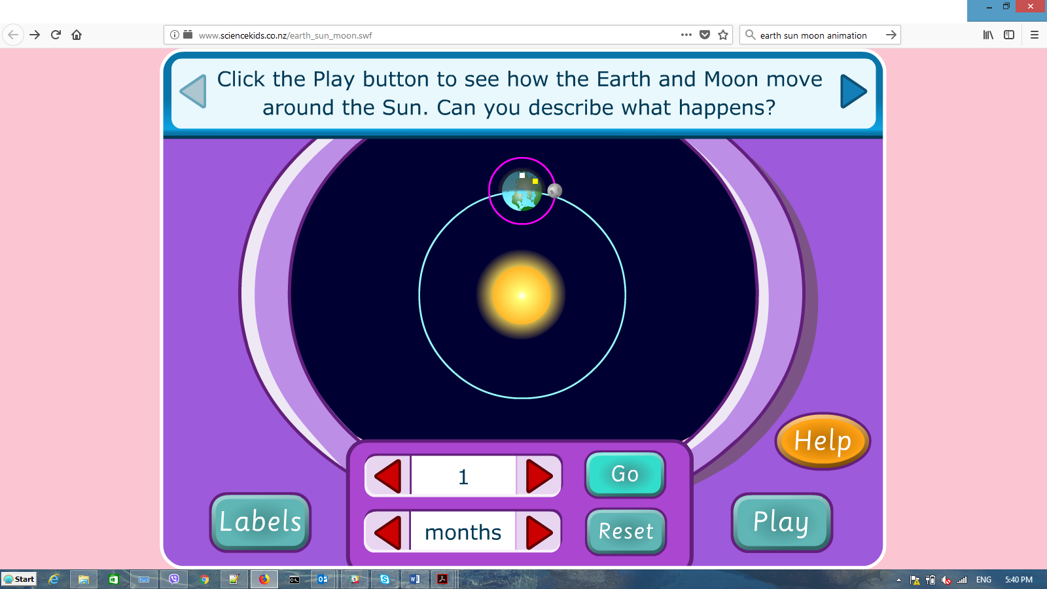
Initial position of the Sun, Earth and Moon

Slide 5
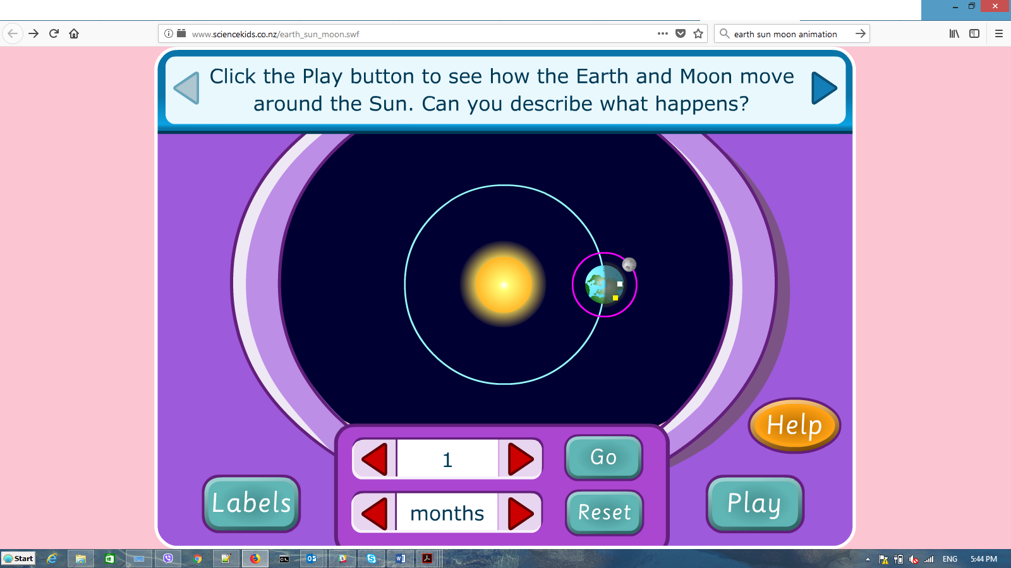
9 Months later, finger pointing direction changes

Slide 6
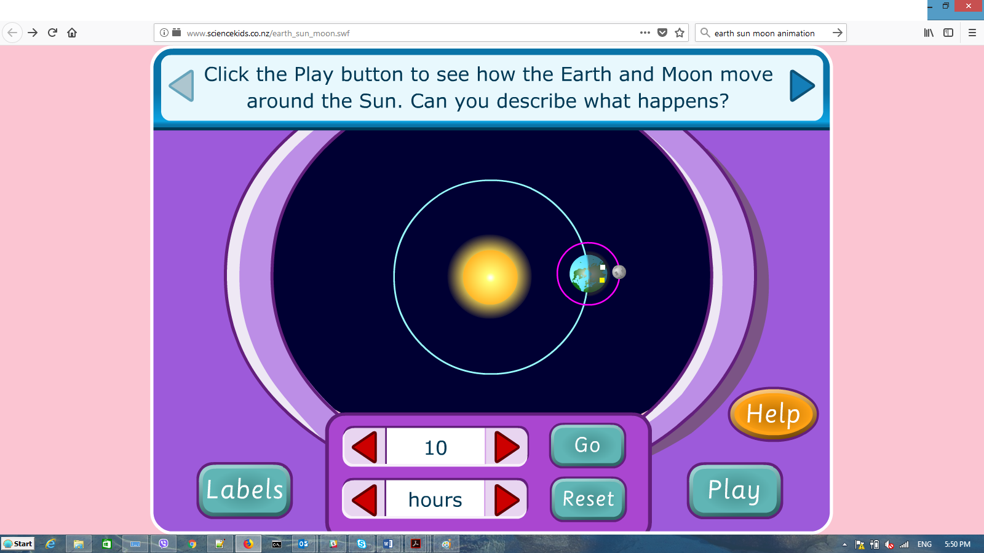
70 hours later, 2 actors can contradict (if they can see the “empty” moon!!!)

Slide 7
Conclusion
Yours to conclude!

